Slide 1
Guess by picture

Slide 2
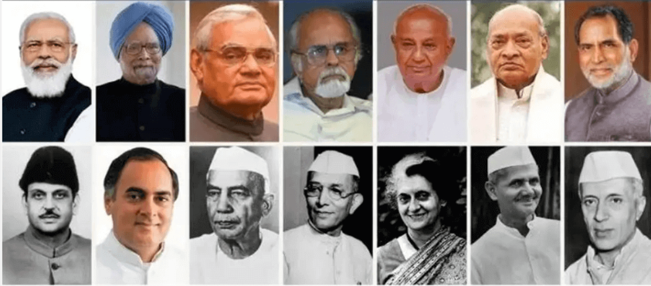
Guess their name

Slide 3
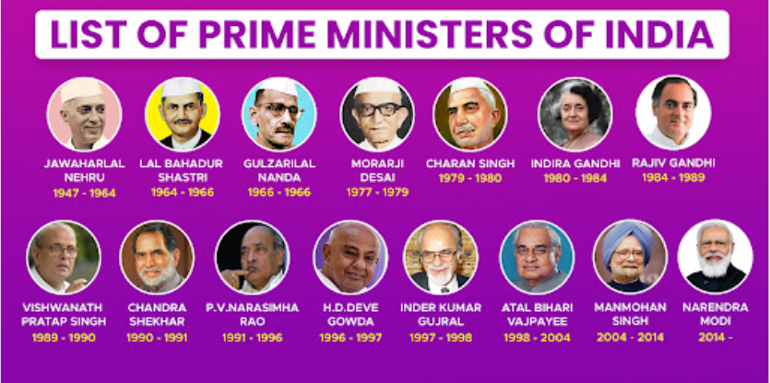

Slide 4
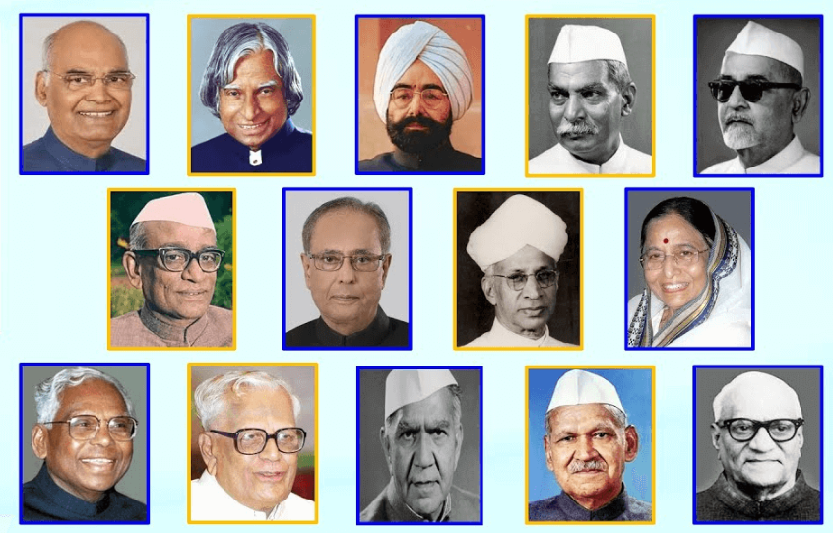
Guess their role

Slide 5

Guess our current president

Slide 6
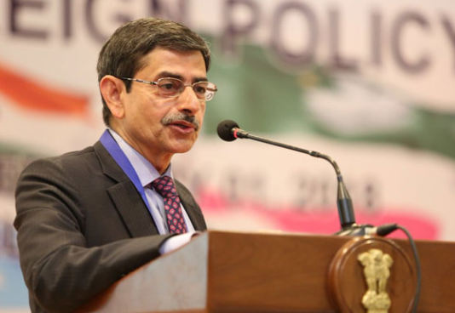
Guess his role and name

